Slide 1

DocEasy
Appointments
Made easy
Batch 18
Snega M
Vimalan S
Yuvaraj D

Slide 2

PROBLEM STATEMENT
Appointment to doctors are not
Done in an efficient manner
There is a need for a web application that facilitates convenient and efficient scheduling of doctor appointments for patients.
Traditional methods of scheduling appointments over the phone or in person can be time-consuming, prone to errors, and may lead to scheduling conflicts or missed appointments.
A dedicated web application can streamline the process, enhance patient experience, and improve overall healthcare service efficiency.

Slide 3

OBJECTIVE
To Create a Web Application for Easily Managing Doctors Appointments
The Application Provides Facility to :
To Create and manage appointments for doctor
To book and manage appointment for user

Slide 4
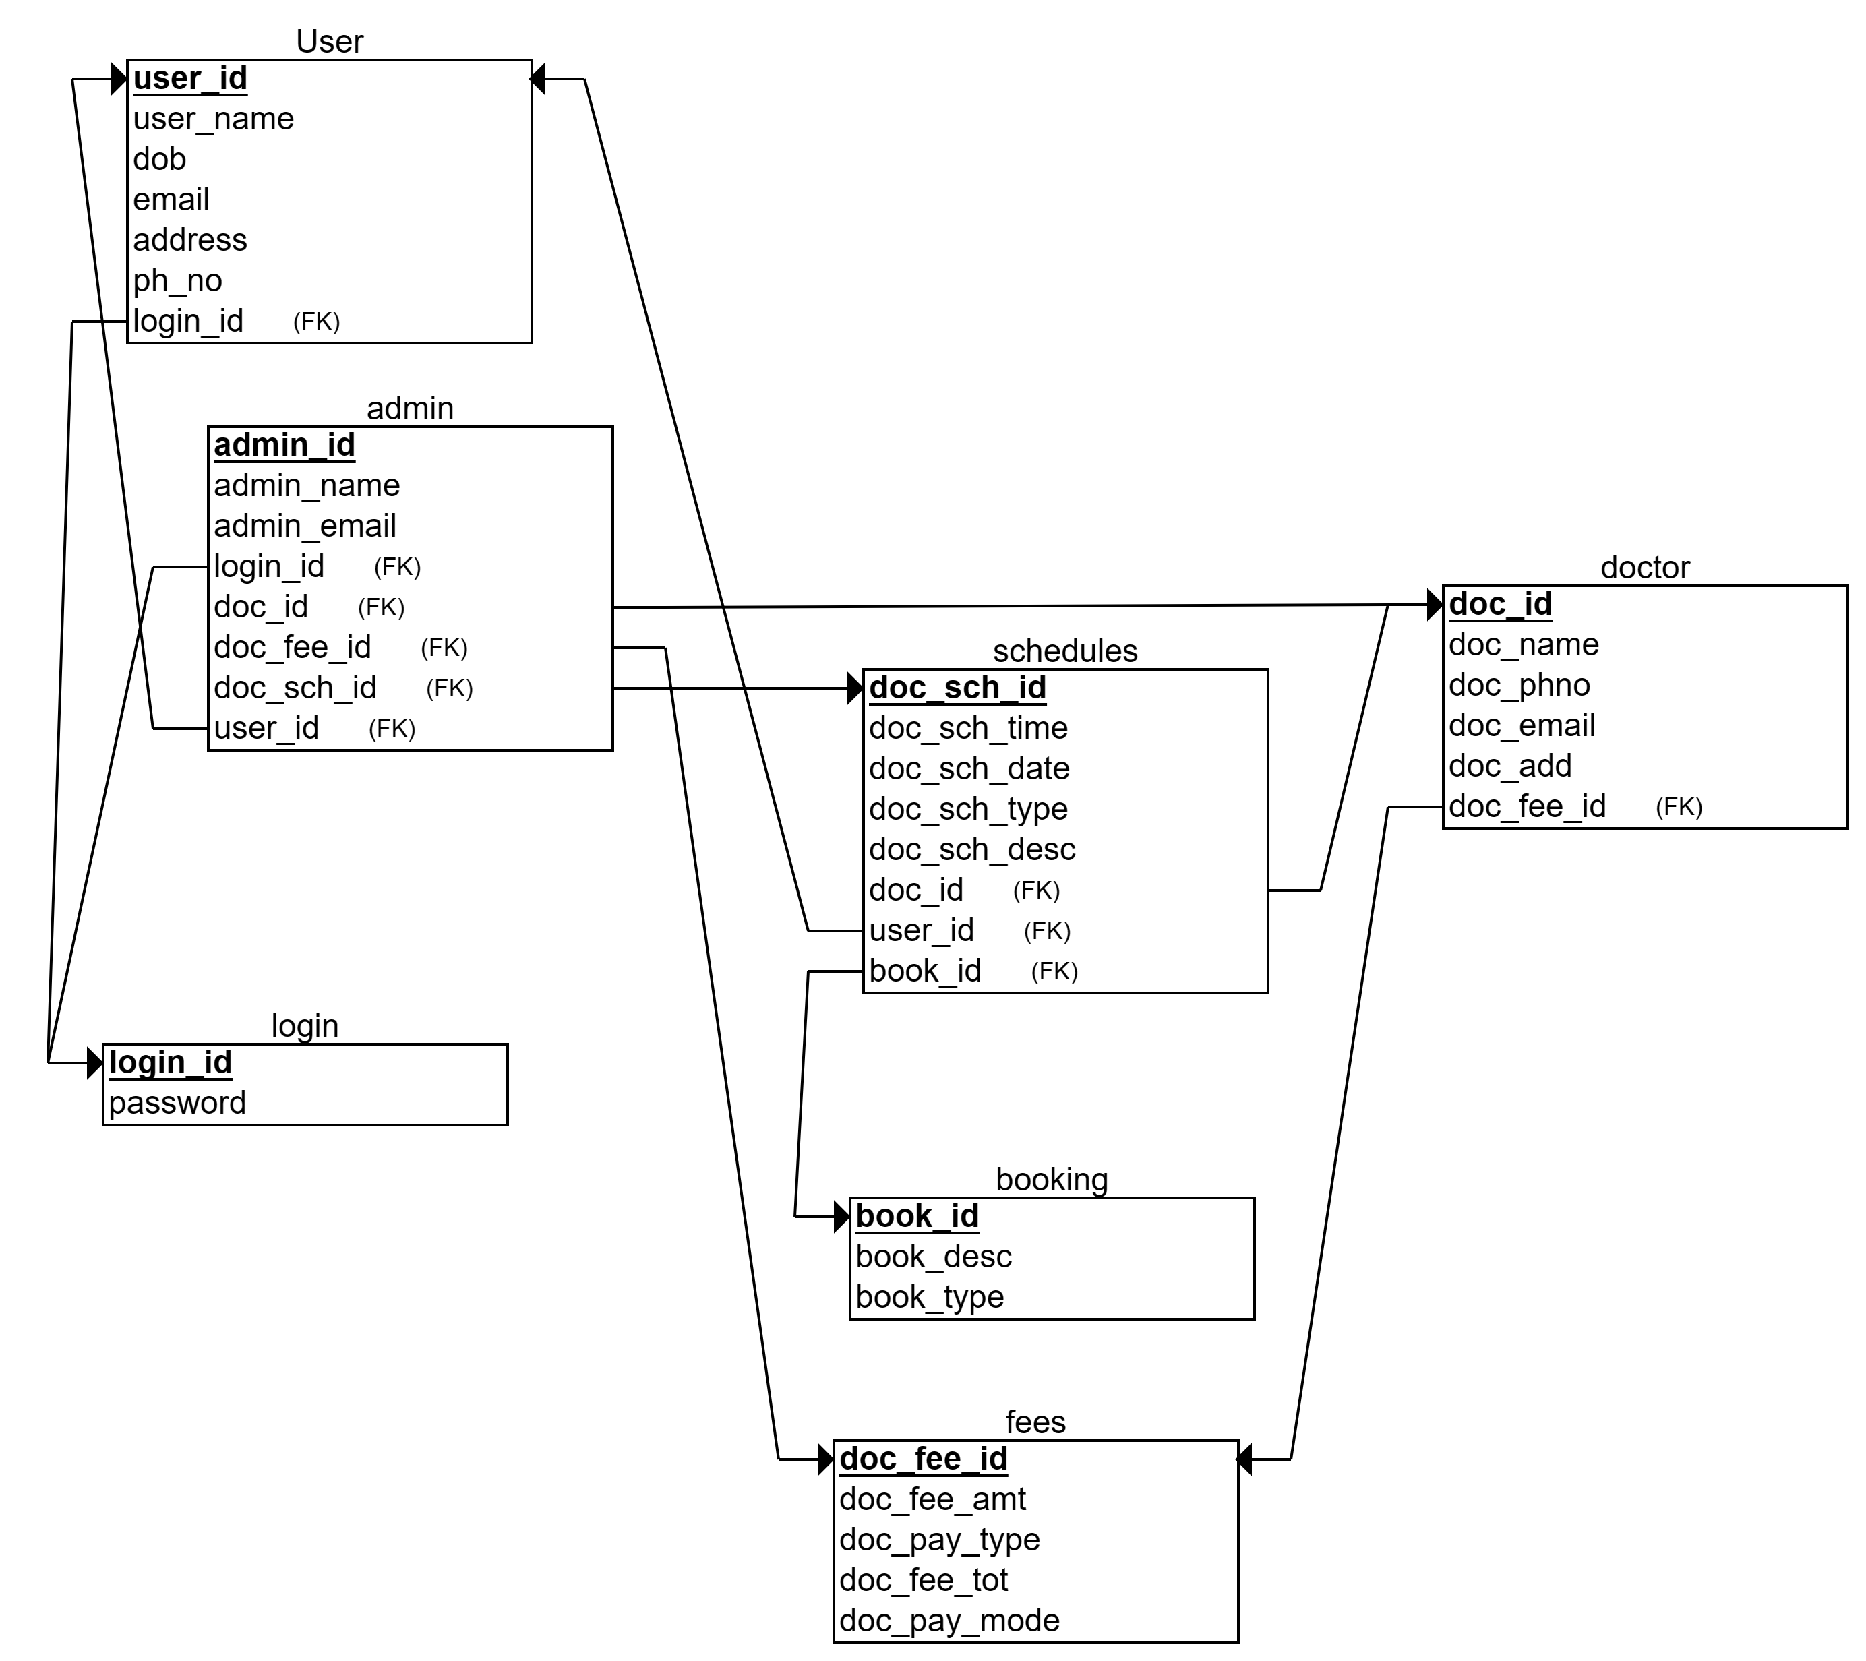
SCHEMA DIAGRAM

Slide 5

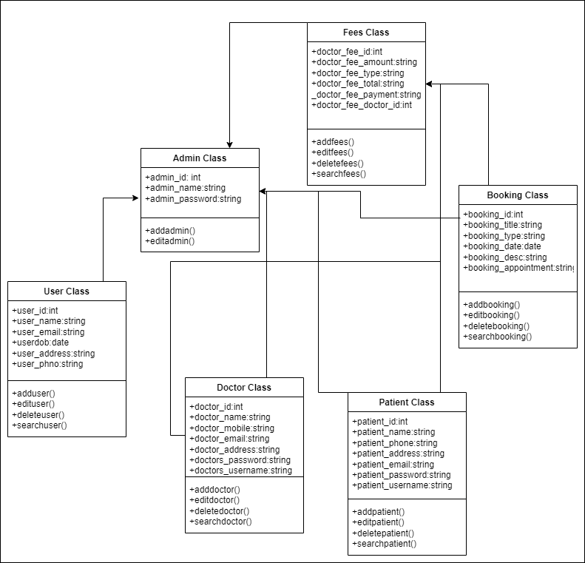
CLASS DIAGRAM

Slide 6

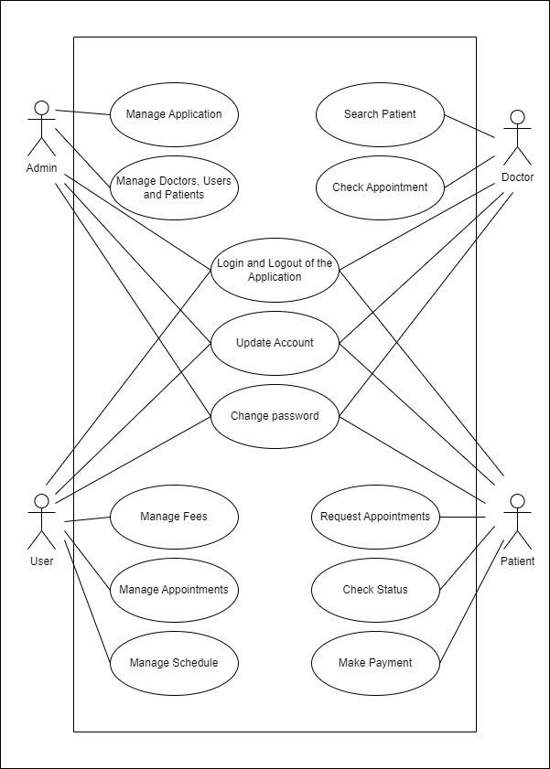
USE CASE DIAGRAM

Slide 7
TECHNOLOGY STACK
Frontend React.js
Backend Spring Boot
Database MySQL, MongoDB
ORM Mapping Hibernate
Unit Testing JUnit, Mockito
Code Coverage Jacoco

Slide 8
THINGS IMPLEMENTED
React UI : Frontend is Developed with React UI
Microservice : Has 3 MicroService -Doctor -Appointment –Availability
Hibernate JPA : Each Microservice is connected to A Separate Database -Doctor - MongoDb -Appointment - MySQL -Availability – MySQL
MicroService Communication : Appointment ms & Availability ms Communicate With Each other to Know if There is Availability for a Doctor if true then Appointment is booked & details stored in Database
Docker : Dockerised React, Microservices & Databases Individually

Slide 9
THINGS THAT ARE YET TO BE IMPLEMENTED
Login SignUp Page : as SpringSecurity dependency has Features like ThymeLeaf & Oauth have to Research on it and Implement Login Signup

Slide 10
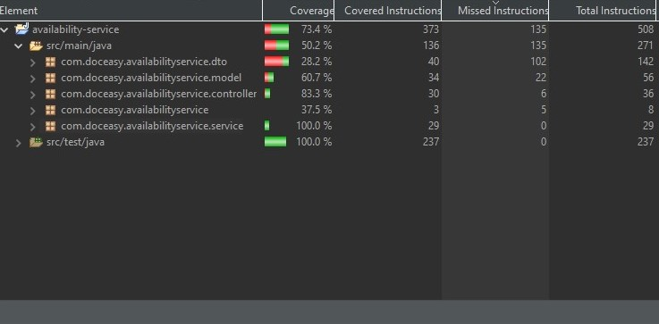
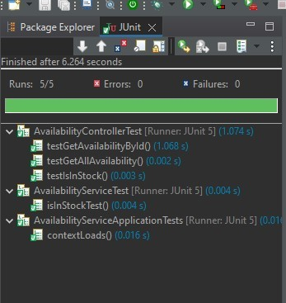
CODE COVERAGE

Slide 11
THINGS THAT CAN BE IMPLEMENTED TO IMPROVE THE WEB APPLICATION
Role Based Login For Doctor to Input their Availability
Admin panel for an Admin to Verify and Add or Edit Doctors

Slide 12

THANK YOU!
Snega M
Vimalan S
Yuvaraj D

